Slide 1



MOBILE & PERFORMANCE
TESTING PROJECT
Team Members:
-Aya Shanteer
-Aya Abu Ali
-Haya Abu Hajeer
-Ahmad Badaha

Slide 2




PROJECT OVERVIEW
Delivered two projects:
-Mobile Automation Testing (LinkedIn)
-Performance Testing (JSON Placeholder)

Slide 3




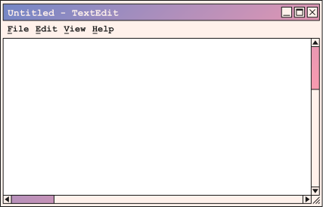
Linked
LinkedIn is a professional networking app that connects millions of users worldwide. It allows members to manage their profiles, connect with other professionals, search for jobs, post updates, like and comment on content, and send messages. The app helps users grow their professional network, showcase their experience, and stay updated with industry news.

Slide 4



Tested Functionalities
1) Profile Management (Ahmad)
2) Search & Networking (Haya)
3) Feed & Posts (Aya sh)
4) Messaging (Aya abu)

Slide 5
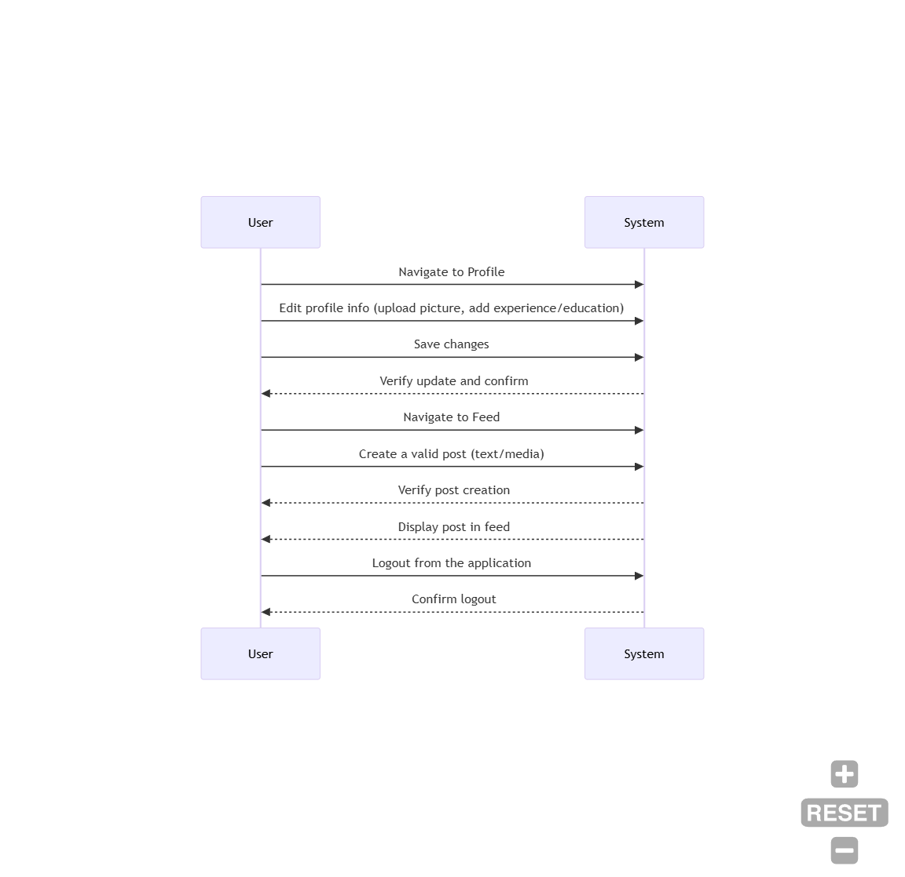
Workflow & UML

Slide 6

SOFTWARE TESTING
LIFE CYCLE
01 Requirements Analysis
02 Test Planning
03 Test Design
04 Test Execution
05 Test Summary

Slide 7

SRS Document (Requirements Analysis)
We began by thoroughly reviewing the system requirements, which led us to develop the Software Requirements Specification (SRS) document.
Test Plan
we designed the Test Plan to outline the testing strategy, objectives, scope, and procedures for the project.

Slide 8


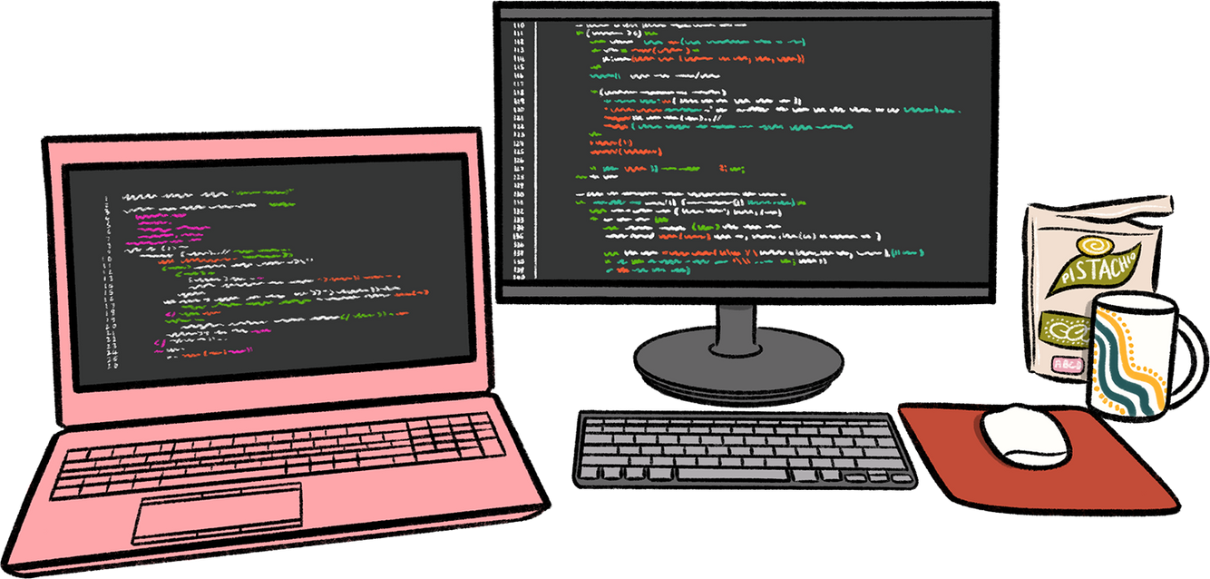
Test Cases Design
Based on the Test Plan, we developed detailed Test Cases to verify each feature, covering positive, negative, and edge scenarios.
Writing the code
We implemented the code using Appium automation scripts in Java to validate the mobile application’s functionality.

Slide 9

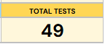
Test Summary
All planned tests were executed successfully with no major issues found.
RTM (Requirement Traceability Matrix)
We developed the RTM to ensure complete test coverage by mapping each requirement to its corresponding test cases. All requirements were covered and validated.
Bug Report
No bugs were detected during the testing process, confirming the system’s stability and reliability

Slide 10




JSON Placeholder
PERFORMANCE
TESTING
JSONPlaceholder is a free fake REST API that developers and QA engineers use for testing and prototyping. It provides ready-made endpoints like /posts, /comments, /users, and more, which simulate real API behavior without needing a backend. It’s widely used for learning, practicing automation, and running performance or integration tests.

Slide 11
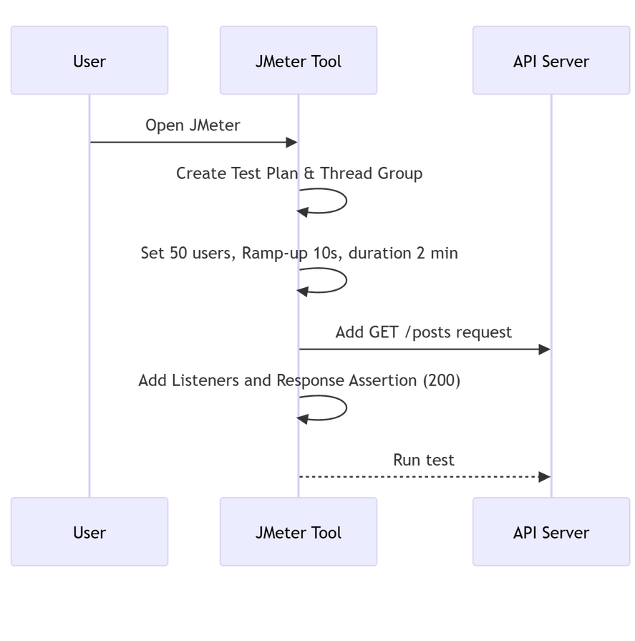
Workflow & UML

Slide 12

SRS Document (Requirements Analysis)
Test plan
Test Case Design

Slide 13
We executed the tests using JMeter to validate both functionality and performance.
Executing The Test Cases Through Jmeter
We recorded the issues in structured bug reports, documenting failed scenarios such as high response times and unexpected errors during load testing.
Bug Report
RTM

Slide 14

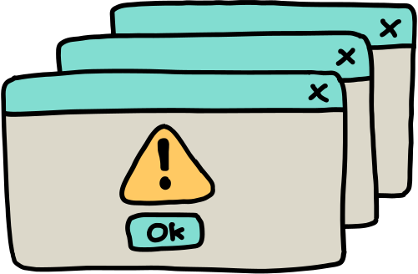
Test Summary
Test Cases: 10
Bugs: 3
Severity: 3 Low
priority: 1 Low ,2 Medium

Slide 15
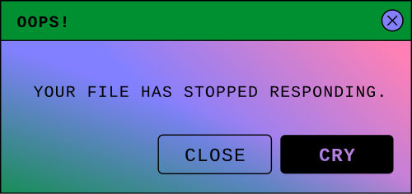
Tools & Frameworks Used
Appium – Mobile automation testing
Android Studio – Emulator & mobile testing environment
JMeter – Performance testing and load simulation
TestNG / JUnit – Test execution & reporting
Google Drive – Documentation & file sharing
Trello – Task management & sprint tracking
GitHub – Version control & code repository

Slide 16

Challenges & Solutions
Challenge (1) : Test Environment (Android studio)
Challenge (2) : Time management
Solution: Task division & Daily Scrum alignment & selecting a different emulator

Slide 17

Thank you

